Slide 1
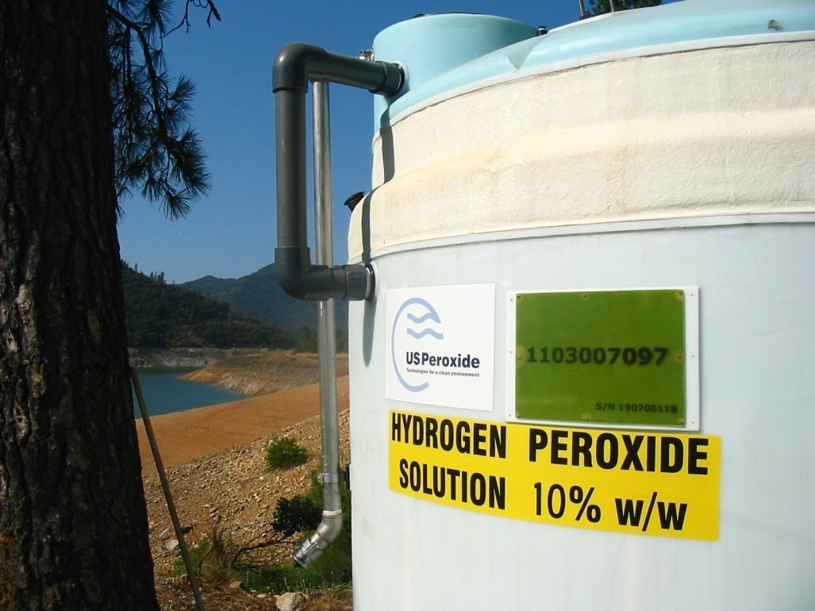
Total Chemical Management for Remediation
Safety and Risk Management
System Engineering
Installation and Commissioning
Multi-Chemical Supply
Project and Chemical Logistics
Field Service and Maintenance

Slide 2
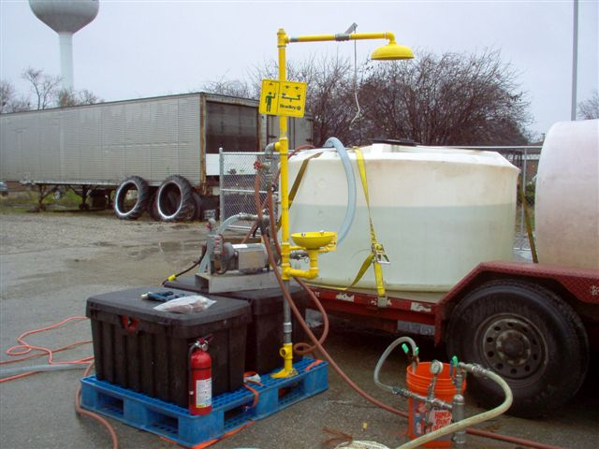
Safety and Risk Management
Site Process Hazards Analysis via new site forms
Pre-startup safety reviews
Equipment design and installation per strict USP and industry standards
Project specific safety and operations training
Safe mobilization and demobilization
Incident investigation
Annual corporate training programs

Slide 3
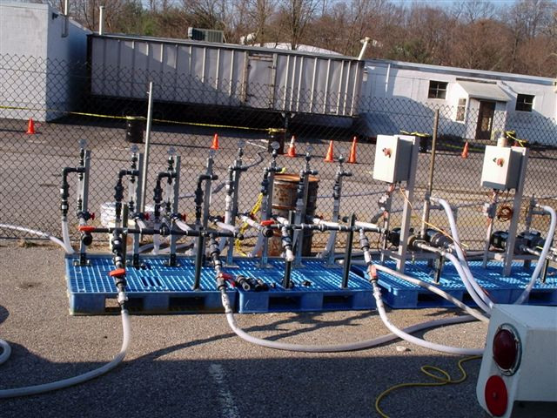
Custom Designed Systems
Customized equipment design and fabrication
Modular systems design for quick assembly
On-site dilution and dry chemical mix systems
USP installation and commissioning
Safety and operations training

Slide 4
Logistics and TCM
Oxidants
Hydrogen Peroxide
  Custom concentrations delivered to site (up to 50%)
  On-site dilution systems
Percarbonate
Permangenate
All FMC chemicals
  Klozur (sodium persulfate)
  PermeOx
  Klozur OBC
Specialty VeruTEK Remediation Products
Activators
Ferrous Sulfate (dry and in solution) / Chelated Solutions (EDTA)
Hydrogen peroxide
Caustic
Heat
Lime
USP Provides the full suite of remediation chemicals

Slide 5
Field Service and Maintenance
USP Field Personnel are highly trained with years of H₂O₂ and complimentary chemical experience
Preventive maintenance programs are developed for each system
All systems initially installed and commissioned by USP
Technical support and troubleshooting available with 48 hour typical response
Periodic inspections performed for longer term projects

Slide 6
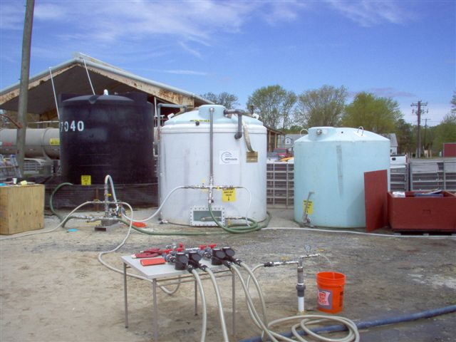
USP Rapid Response & TCM Programs
50% Storage
Catalyst Storage (FeSO4)
H₂O₂ Dilution Tanks
Flow Control Station
Wellhead Adapter/Vent
Chemical Pump System

Slide 7
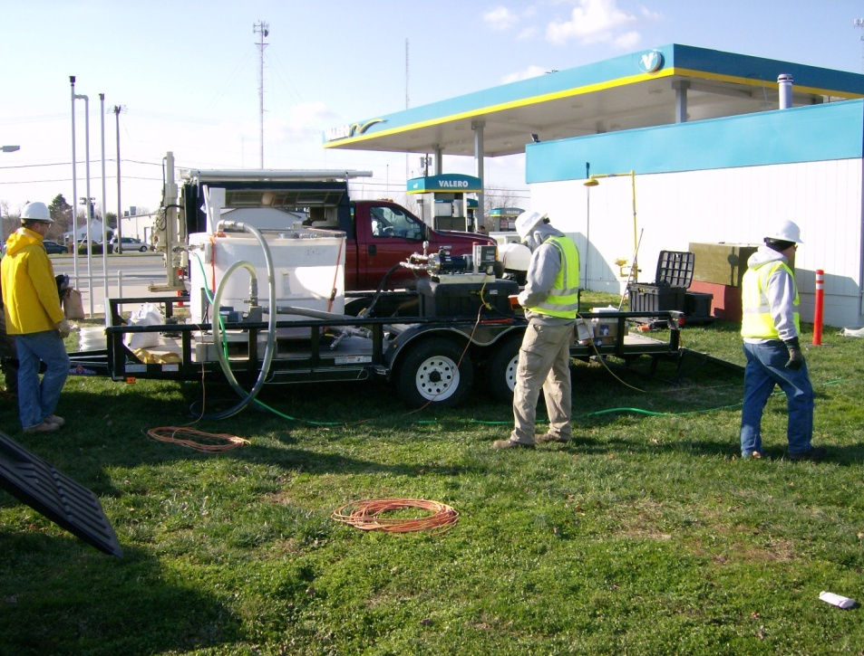
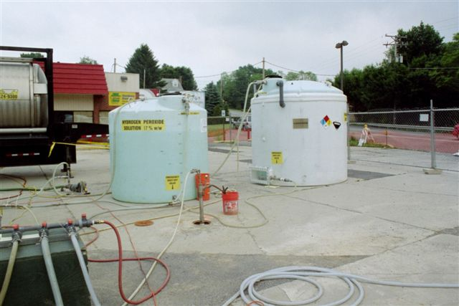
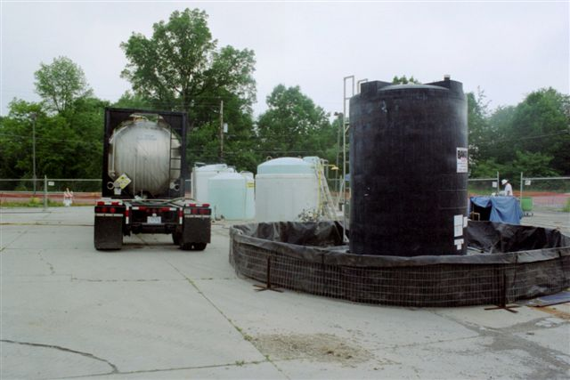
Mobile Dry Chemical Mix System
Custom Dilution Tank Systems
Mobile Safety Stations
Multi-Chemical
Bulk Storage

Slide 8
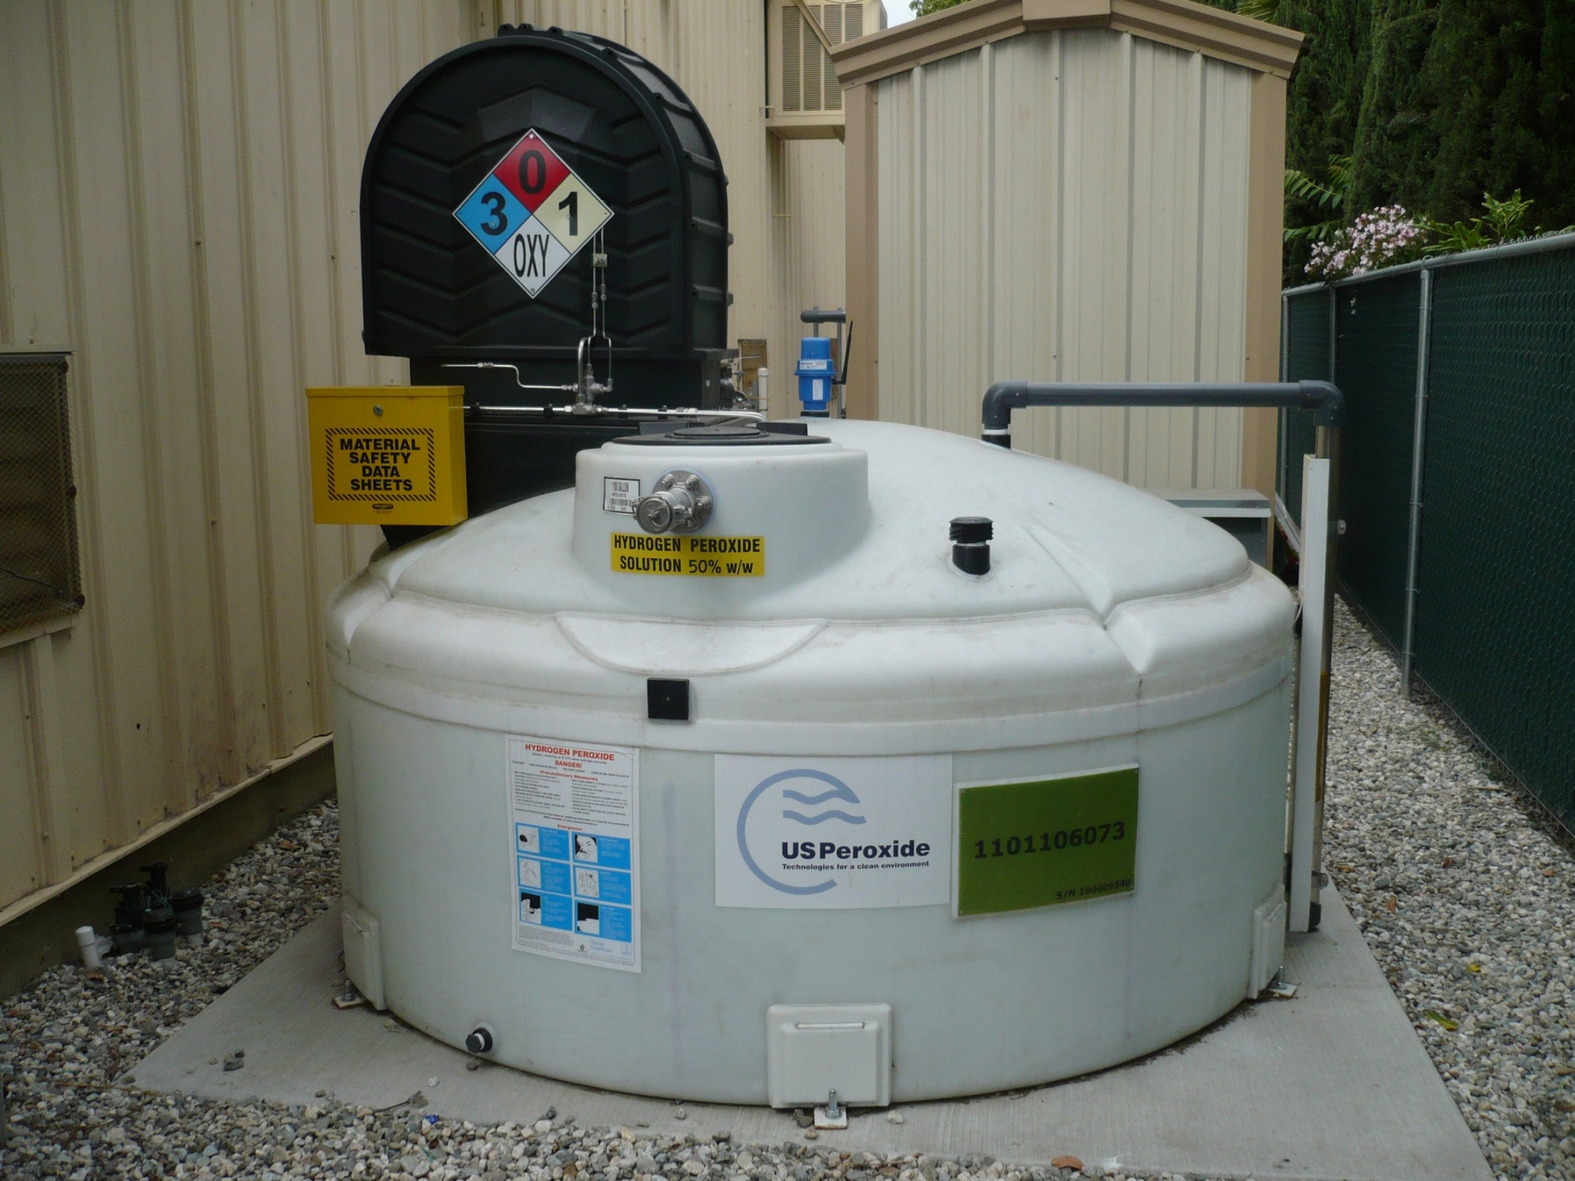
USP-1100
Dosing Module
W / Environmental Enclosure
Safety Placards
Inventory Monitor
Level Sensor
Local Level Indicator
Fill Connection
Primary Tank
Secondary Tank
(110% containment)
Seismic Tie downs
(optional)

Slide 9
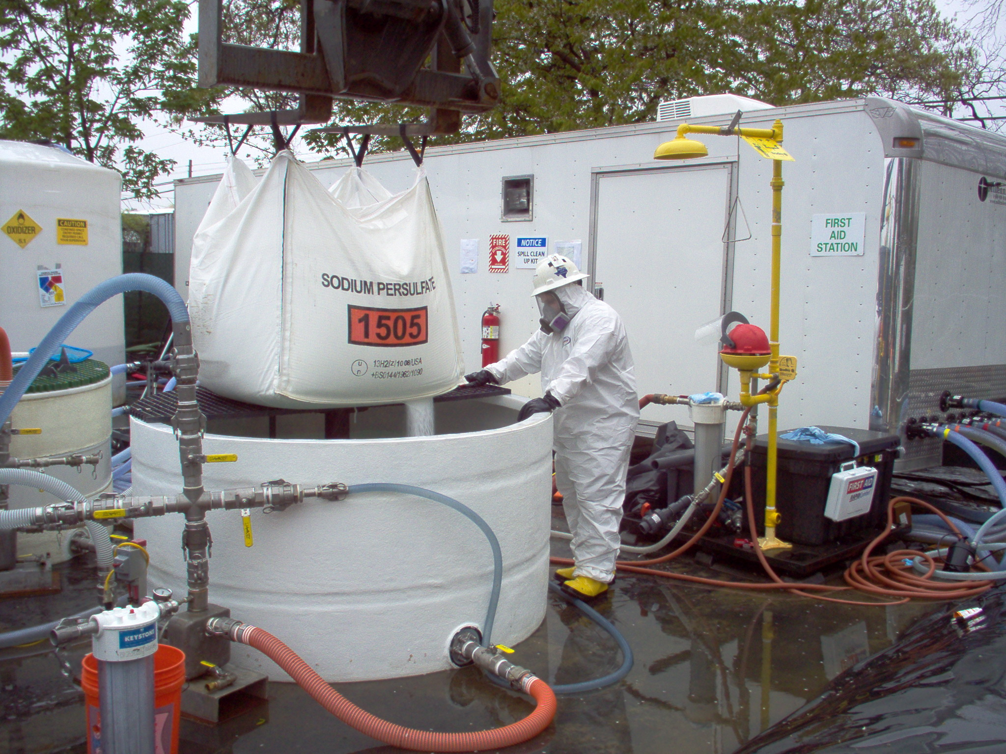
USP-650 Dry Mix
Safety Shower/
Eyewash Unit
Field Service
Technician
650-gal Mix Tank w/ Eductor
Chemical Containment Berms

Slide 10
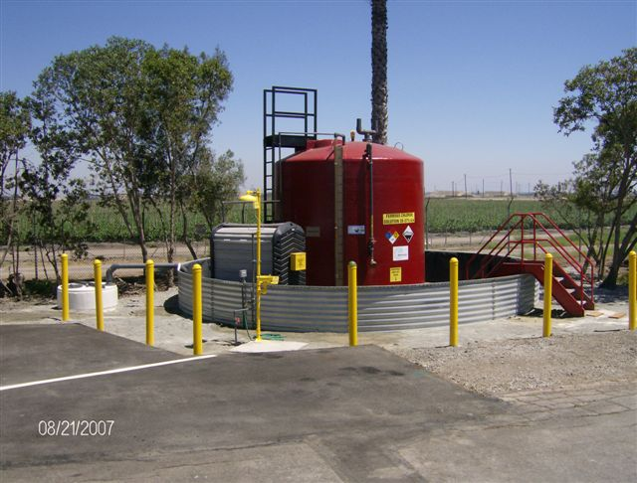
USP -9000 Iron Salt Dose System
Access Ladder
9K HDPE Storage Tank
(color per customer spec)
Reverse Level indicator
Fill Line
Chemical Labels/Placards
Dose Line Leak
Detection Station
(optional)
Traffic Control (if applicable)
Emergency Response Station
Dual Pump Dosing Module
Site Containment System

